Slide 1
Fitchburg – Energy Plan
July 2020

Slide 2
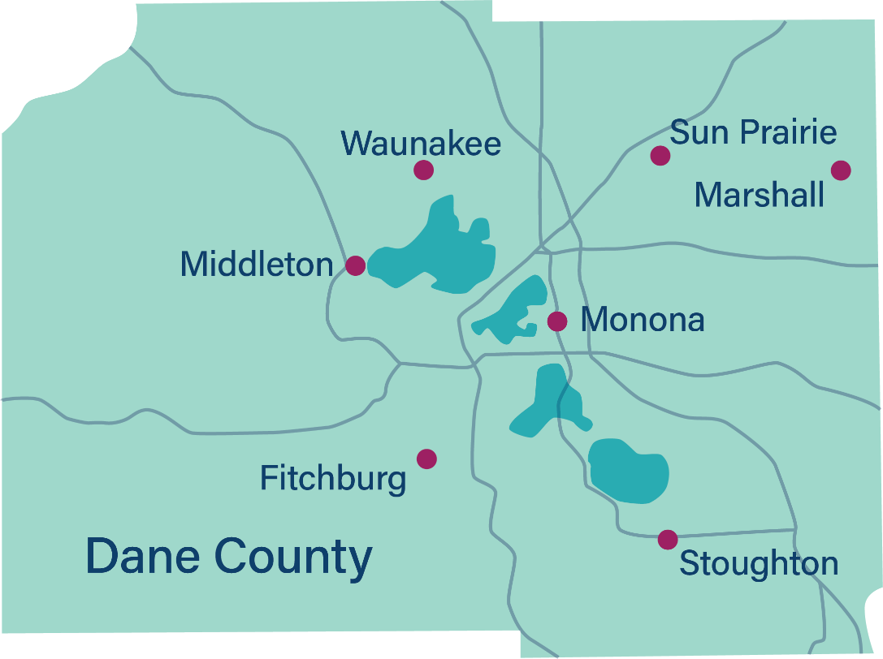
Overview of energy planning
Energy plan
Building level opportunities
Distributed generation
Fleet upgrades
Process, policies, and procedures
Street lighting upgrades
This energy planning work was supported by a grant from the Office of Energy Innovation

Slide 3
Energy profile

Slide 4
Energy plan development overview
Data gathering
Development of energy profiles
Opportunities analysis
Utility and streetlight data
Vehicles and mileage
Operational and internal policies
Compile data in standard format
Identify areas of missing information
Conduct secondary research to develop assumptions
Create a spreadsheet of compiled data
Conduct site visits
Develop list of opportunities
Calculate energy and costs savings
Identify municipal policies and community-wide resources

Slide 5
Inventory elements
Buildings | Operations | Fleet
City Hall Library Maintenance Safety Building/Firehouse 1 Community Center New Fire Station Police Processing | Non-street lighting Other operation Parks and Rec Public Works Garage Street lights Well/pumps/lifts | 21 Police vehicles 6 Administration vehicles 16 Parks & Recreation vehicles 20 Public Works vehicles 11 Utility vehicles 16 Emergency vehicles
Notes:
Note that the “New Fire Station” named here is our second station on Marketplace Dr, while the new East Fire Station on S Syene Rd wasn’t included in this inventory due to the timeline of data collection and analysis.

Slide 6
Energy and GHG inventory

Slide 7
Energy consumption by use type
*Use type names are standardized across communities

Slide 8
Energy consumption by use type
*Use type names are standardized across communities

Slide 9
Carbon impact of energy
*Use type names are standardized across communities

Slide 10
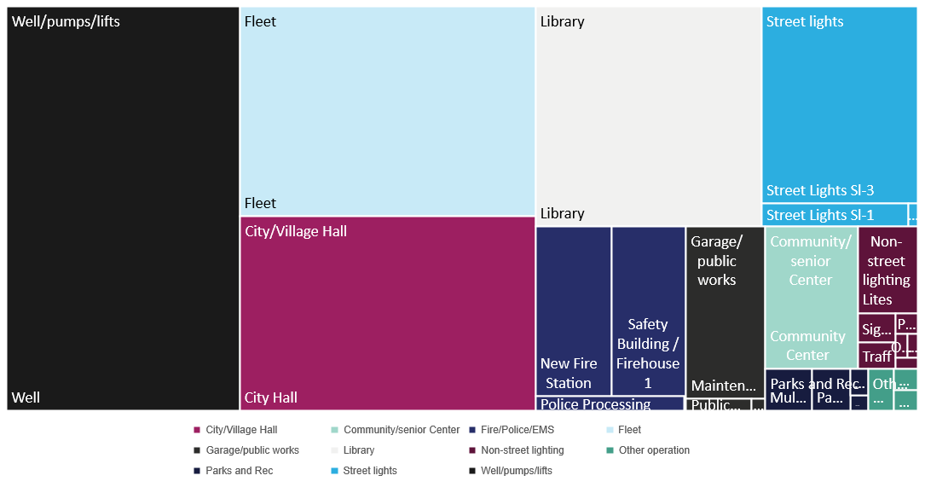
Relative carbon impact of energy

Slide 11
Baseline energy consumption, CO_{2e} emissions and cost
 | Use/building | Electricity (kWh) | Natural gas (therms) | CO₂ dioxide equivalent (metric tons) | Percent of total CO₂ | Energy cost
Buildings | City Hall | 753,097 | 26,878 | 716 | 16% | $98,965
 | Community Center | 167,400 | 6,839 | 164 | 4% | $22,515
 | Fire Station | 167,829 | 6,122 | 160 | 3% | $22,135
 | Library | 809,193 | 274 | 618 | 13% | $89,175
 | Maintenance | 93,173 | 18,559 | 170 | 4% | $21,385
 | Police Processing | 32,080 | 484 | 27 | 1% | $3,820
 | Safety Building | 139,600 | 9,763 | 158 | 3% | $21,215
Operations | Non-street lighting | 139,049 | - | 106 | 2% | $15,295
 | Other operation | 37,365 | - | 29 | 1% | $4,110
 | Parks and Rec | 58,840 | 1,772 | 54 | 1% | $7,535
 | Public Works Garage | 13,122 | - | 10 | 0.2% | $1,445
 | Street lights | 559,012 | - | 426 | 9% | $61,490
 | Well/pumps/lifts | 1,572,247 | - | 1,197 | 26% | $172,940
 | Fleet |  |  | 770 | 17% | $234,250
Total |  | 4,542,007 | 70,691 | 4,605 |  | $776,275

Slide 12
Renewable energy quick facts (2018)
Source | kWh
On-site net metered solar (kWh) | 412,680
On-site export-metered solar (kWh) | 24,399
Green Power Tomorrow purchases (kWh) | 20,826
Total renewable energy | 457,905
Percent total gross electricity | 9.1%

Slide 13
Renewable energy quick facts (2018)
Source | kWh
On-site net metered solar (kWh) | 412,680
On-site export-metered solar (kWh) | 24,399
Green Power Tomorrow purchases (kWh) | 20,826
Solar acquired via MG&E grid energy* | 478,209
Total renewable energy | 936,114
Percent total gross electricity | 18.3%
*assumes 10.5% renewables in grid mix, 4,554,373 kWh purchased from MG&E (minus GPT), 96,467 kWh from Alliant

Slide 14
Renewable energy quick facts (2019)
Source | kWh
On-site net metered solar (kWh) | 372,566
On-site export-metered solar (kWh) | 20,404
Green Power Tomorrow purchases (kWh) | 20,250
Solar acquired via MG&E grid energy* | 499,767
Total renewable energy | 912,987
Percent total gross electricity | 17.3%
*assumes 10.5% renewables in grid mix, 4,759,690 kWh purchased from MG&E (minus GPT), 96,920 kWh from Alliant

Slide 15
Renewable energy quick facts (2021 projected)
Source | kWh
On-site net metered solar (kWh) | 372,566
On-site export-metered solar (kWh) | 20,404
Green Power Tomorrow purchases (kWh) | 20,250
Solar acquired via MG&E grid energy* | 499,767
Projected energy from O’Brien solar array | 972,500
Total renewable energy | 1,885,487
Percent total gross electricity | 35.8%
*assumes 10.5% renewables in grid mix, 4,759,690 kWh purchased from MG&E (minus GPT), 96,920 kWh from Alliant

Slide 16
Comparison to other communities

Slide 17
Building energy consumption comparison
Note: this data is for building-level data only and excludes water distribution or treatment energy as not all communities have or included water distribution or treatment data.
Notes:
Buildings only, no operations

Slide 18
Energy and carbon summary by municipality
Municipality | Total electricity (kWh) | Total natural gas (therms) | Total carbon emissions (CO₂e, including fleet)
Fitchburg | 4,542,007 | 70,691 | 4,605
Marshall | 974,489 | 30,404 | 1,002
Middleton | 4,575,577 | 115,173 | 4,615
Monona | 1,910,175 | 70,878 | 2,133
Stoughton | 1,675,563 | 99,450 | 2,209
Sun Prairie | 6,886,758 | 162,024 | 7,011
Waunakee | 1,766,740 | 82,477 | 2,142
Notes:
The total electricity consumption lists the amount of electricity that the municipality purchased from the utility, rather than the total electricity used by the municipality, due to net-metering billing arrangements for those municipalities that have on-site solar. Net-metered solar photovoltaic systems first provide electricity to power operation of the facility where the system is located, thereby reducing the amount of electricity that the facility must purchase from the utility. Solar electricity that is used on-site is generally not shown on the facility’s electric statement but is instead reflected in the reduced amount of electricity that it purchases from the utility.

Slide 19
Comparisons

Slide 20
Building efficiency

Slide 21
Benchmarking
The American Society of Heating, Refrigerating and Air-Conditioning Engineers (ASHRAE) created Standard 100-2018 - Energy Efficiency in Existing Buildings that offers median EUI values as well as energy targets by building type. https://www.ashrae.org/news/esociety/updated-standard-100-published

Slide 22
Building efficiency analysis process
Fitchburg buildings visited:
- City Hall
- Community Center
Select two or three buildings
Conduct high-level walk-through
Identify opportunities
Calculate energy and cost savings
Share opportunities from other communities

Slide 23





Prioritizing energy upgrades
First costs and energy savings potential
Occupant comfort, health, safety
Maintenance
Equipment end-of-life replacement opportunities
Carbon reduction

Slide 24
Common energy saving upgrades across all communities
Lighting
Interior and exterior LED lighting retrofits
Lighting occupancy and vacancy controls
Daylighting controls
Task tuning to optimize lighting output
Exterior lighting controls
Retrocommissioning for lighting controls
HVAC
Air handling unit supply air temperature reset
Boiler hot water temperature reset
Demand-controlled ventilation (DCV) controls
Retrocommissioning for HVAC
Plug Loads
Computer power management
Server room cooling

Slide 25
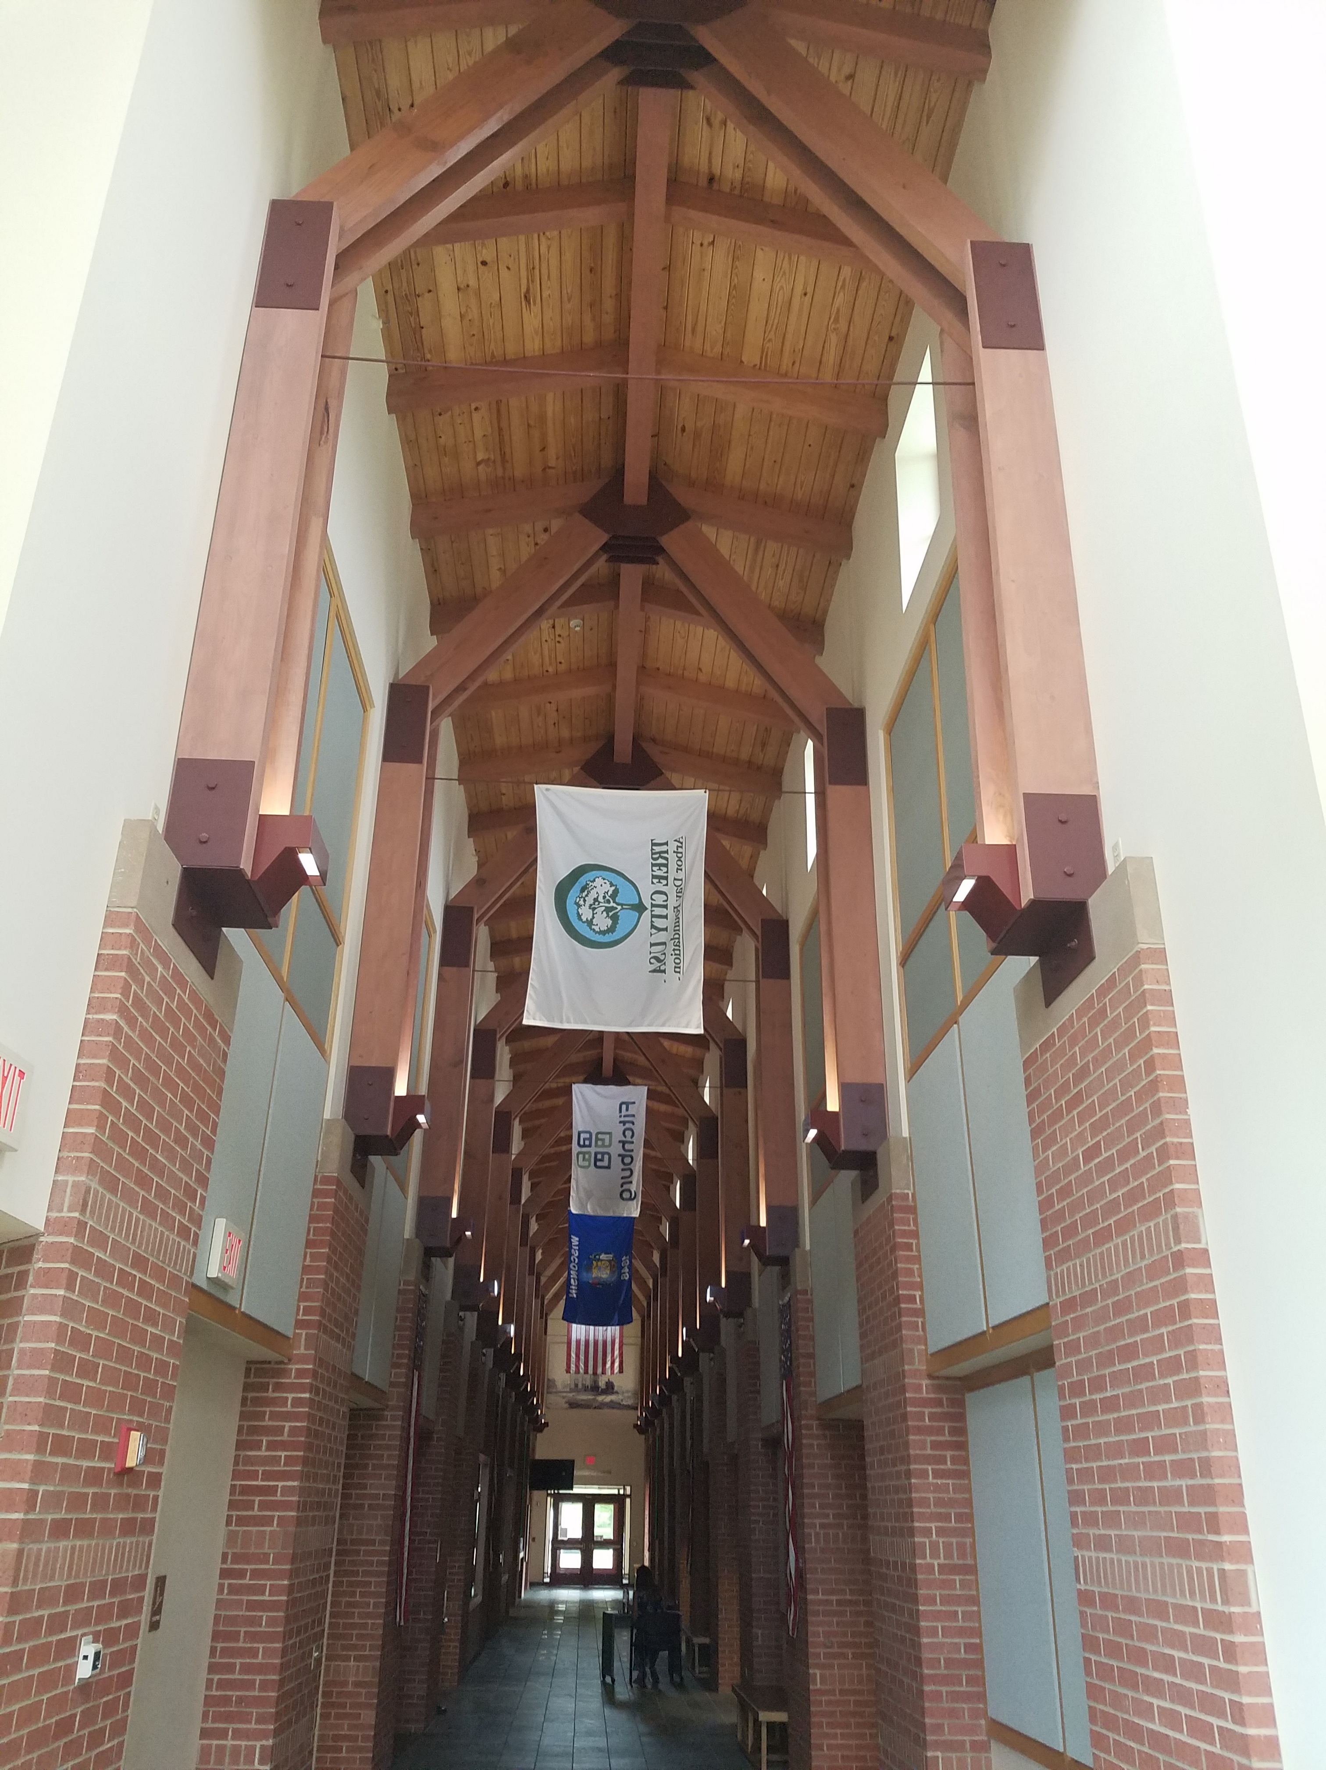
City Hall
Summary
  Most lighting is fluorescent or metal halide
  Cold spots in open office areas in the summer
  TV station area has specific needs
Opportunities
  Lighting upgrades
  Consider moving AV data server into smaller room with dedicated split system
  Convert primary chiller to variable volume
  Add a small summer boiler to improve thermal comfort

Slide 26
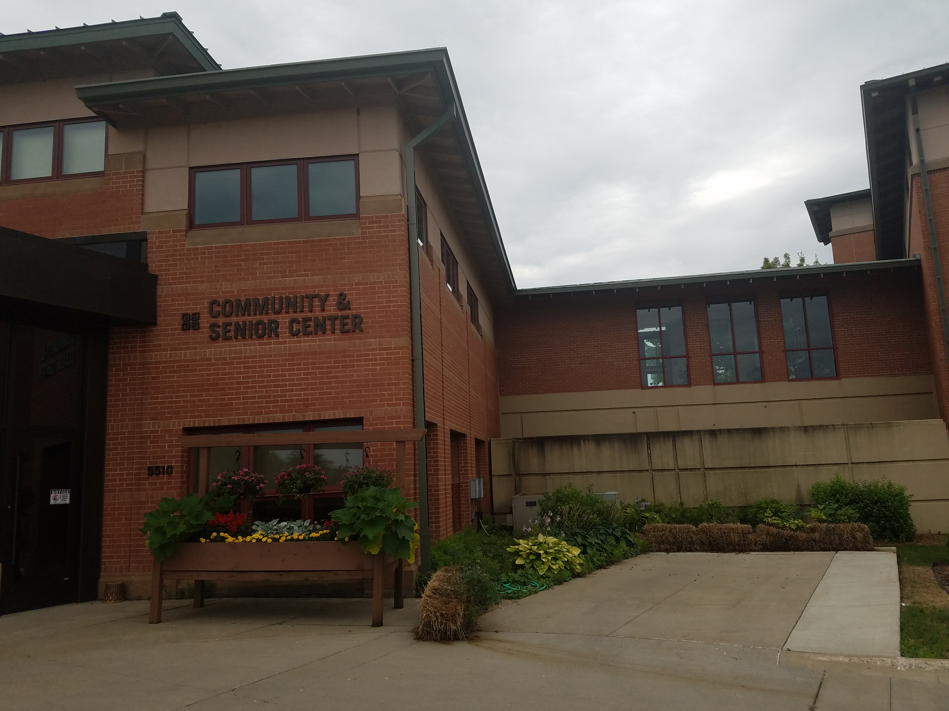
Community and Senior Center
Summary
  HVAC system well designed from thermal comfort standpoint
  LED upgrades on-going
Opportunities
  Consider lighting vacancy sensors for offices
  Consider implementation of HVAC controls

Slide 27
City Hall energy savings
Measure | Cost | Electric savings (kWh) | Gas savings (therms) | Total energy savings | Cost savings | Simple payback (years)
HVAC AHU reset | $290 | 5,540 | 600 | 1.6% | $970 | 0.3
Lighting controls - daylighting | $130 | 3,800 | -80 | 0.1% | $370 | 0.3
Lighting controls - occupancy | $320 | 8,950 | -200 | 0.2% | $860 | 0.4
Lighting controls - garage | $170 | 4,070 | -90 | 0.1% | $390 | 0.4
HVAC boiler reset | $1,220 | 0 | 2,060 | 4.1% | $1,240 | 1.0
LED lighting - task tuning | $950 | 5,660 | -130 | 0.1% | $550 | 1.7
DCV - assembly space | $1,820 | 1,840 | 980 | 2.0% | $790 | 2.3
LED lighting retrofit - interior | $22,000 | 83,680 | -1,870 | 2.0% | $8,090 | 2.7
DCV - office space | $2,580 | 1,240 | 620 | 1.3% | $510 | 5.1
City Hall Total | $29,480 | 114,800 | 1,890 | 11.5% | $13,760
^{[1]} Negative values reflect an increase in heating demand due to interactive effects – in all cases total savings is still positive.

Slide 28
Community Center energy savings
Measure | Cost | Electric savings (kWh) | Gas savings (therms) | Total energy savings | Cost savings | Simple payback (years)
Lighting controls - daylighting | $80 | 2,370 | -50 | 0.2% | $230 | 0.3
Lighting controls - occupancy | $200 | 5,580 | -120 | 0.5% | $540 | 0.4
HVAC AHU reset | $190 | 2,840 | 310 | 3.1% | $500 | 0.4
LED lighting - task tuning | $490 | 3,530 | -80 | 0.3% | $340 | 1.4
LED lighting retrofit - interior | $10,060 | 31,700 | -710 | 2.9% | $3,060 | 3.3
DCV - assembly space | $1,490 | 1,000 | 530 | 4.3% | $430 | 3.5
HVAC boiler reset | $1,220 | 0 | 570 | 4.4% | $340 | 3.6
DCV - office space | $260 | 80 | 40 | 0.3% | $30 | 7.6
Community Center Total | $13,990 | 47,100 | 480 | 16.1% | $5,470
Notes:
Gas savings are negative because more efficient lighting gives off less heat, thereby increasing the space heating needs

Slide 29
Non-site visit buildings: analysis process
Developed 10 standard energy saving measures for 6 building use types
Assigned city buildings use type (or multiple types if applicable)
Calculated energy savings as a function of building square footage and building type
Measures applied to applicable buildings (or parts of buildings)

Slide 30
Non-site visit buildings: potential savings
Building | Cost | Electric savings (kWh) | Gas savings (therms) | Total energy savings | Cost savings | Simple payback (years)
Library
HVAC AHU reset | $100 | 19,380 | 0 | 2.2% | $2,130 | 0.0
LED lighting retrofit - interior | $7,930 | 25,000 | 0 | 2.9% | $2,750 | 2.9
Library Total | $8,030 | 44,380 | 0 | 5.1% | $4,880
Maintenance
Lighting controls - daylighting | $50 | 1,560 | -30 | 0.1% | $150 | 0.3
Lighting controls - garage | $290 | 7,000 | -160 | 0.5% | $680 | 0.4
LED lighting - task tuning | $1,420 | 4,000 | -90 | 0.3% | $390 | 3.7
LED lighting retrofit - interior | $4,380 | 10,350 | -230 | 0.7% | $1,000 | 4.4
Maintenance Total | $6,140 | 22,910 | -510 | 1.6% | $2,210
New Fire Station
HVAC AHU reset | $190 | 2,690 | 290 | 2.5% | $470 | 0.4
Police Processing
LED lighting retrofit - interior | $1,850 | 5,730 | -130 | 5.2% | $550 | 3.3
Safety Building / Firehouse 1
Lighting controls - occupancy | $30 | 920 | -20 | 0.1% | $90 | 0.4
Lighting controls - garage | $230 | 5,480 | -120 | 0.5% | $530 | 0.4
LED lighting - task tuning | $70 | 420 | -10 | 0.0% | $40 | 1.8
LED lighting retrofit - interior | $5,920 | 26,580 | -590 | 2.4% | $2,570 | 2.3
Safety Building / Firehouse 1 Total | $6,250 | 33,400 | -740 | 3.0% | $3,230
Grand Total | $22,460 | 109,120 | -1,090 |  | $11,350
Notes:
Gas savings are negative because more efficient lighting gives off less heat, thereby increasing the space heating needs.

Slide 31
Impact on energy use intensity

Slide 32
Fleet analysis

Slide 33
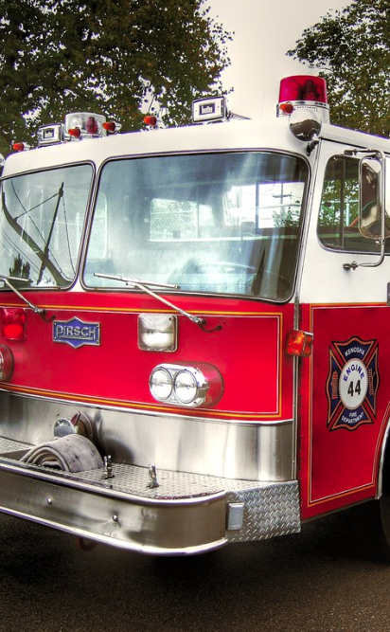
Fleet analysis
Characterized vehicles into 6 types
  Separated diesel & gasoline vehicles
Used city-specific data and secondary data to estimate current costs & carbon footprints
Estimated carbon footprint & costs if alternatives adopted when cost effective

Slide 34
Key vehicle types
Category | Vehicles Included
Police Vehicles | Police department SUVs, motorcycles, pickups, vans, cars
Pickups | Pickups, heavy-duty cargo vans, Jeeps
Heavy Duty | Large pickups (e.g. F550 & F750); plows, dumps, refuse vehicles, cargo trucks, etc.
Emergency Vehicles | Firetrucks, ambulances, fire department SUVs & pickups
Light Duty | Cars, SUVs, vans
Other | Construction equipment, outdoor power equipment, small street cleaning equipment, ATVs

Slide 35
Fitchburg current vehicle fuel usage
Department | Number of vehicles | Gallons | CO₂ (metric tons) | Fuel cost
Police | 21 | 32,188 | 274 | $86,700
Public Works | 20 | 20,410 | 201 | $50,360
Emergency Vehicles | 16 | 10,070 | 132 | $42,470
Parks & Rec | 16 | 10,896 | 101 | $30,480
Utilities | 11 | 5,347 | 55 | $21,850
Administration | 6 | 986 | 8 | $2,390
Total | 90 | 79,897 | 771 | $234,250

Slide 36

Alternatives by vehicle type
Vehicle type | Near-term alternative | Example Manufacturer
Light duty | Full electric or PHEV | Car: many SUV PHEV: many Van PHEV: Chrysler Pacific Transit Van: Electric Ford Transit
Police vehicles | Hybrid electric or full electric | Ford Interceptor SUV hybrid Police Responder Hybrid Sedan Motorcycle: ZERO Motorcycles
Pickups | Hybrid electric or PHEV | F150: PHEV retrofit by XL Fleet Larger (including cargo vans): Hybrid retrofit by XL Fleet Jeeps: Hybrid options
Heavy-duty vehicles | CNG | Freightliner Kenworth Ford retrofits by qualified vehicle modifier
Emergency vehicles | *no widespread alternative* | N/A
Other | *no widespread alternatives* | N/A

Slide 37
Police vehicles – lifetime savings
 | Lifetime | Incremental Vehicle Cost | Annual Cost Savings | Lifetime Savings | Payback Period | Lifetime Carbon Reduction
Hybrid Patrol SUV | 8 | $3,500 | $1,640 | $10,200 | 2.1 | 41%
Hybrid Patrol Sedan | 8 | $3,500 | $2,170 | $14,560 | 1.6 | 55%
Electric Motorcycle | 8 | $390 | $825 | $8,600 | .5 | 35%

Slide 38
Light duty – lifetime savings
 | Lifetime | Incremental Vehicle Cost | Annual Cost Savings | Lifetime Savings³ | Payback Period (years) | Lifetime Carbon Reduction
Passenger Vehicle | 15 | $8,600 | $350 | -$3,700 | - | 43%
Plug-in Hybrid SUV | 15 | $10,000 | $215 | -$7,000 | - | 35%
Plug-in Hybrid Van | 15 | $9,000 | $240 | -$5,650 | - | 35%
As miles driven per vehicle increases, savings will increase & payback will decrease
Accounts for a $0.0128/mile decrease in annual maintenance costs
The cost of a charger is $500 which decreases lifetime savings by about 500

Slide 39
Pickups – lifetime savings
 | Lifetime | Incremental Vehicle Cost | Annual Cost Savings | Lifetime Savings | Payback Period | Lifetime Carbon Reduction
F150 Plug-in Hybrid¹ | 15 | 20,000 | 565 | -12,160 | - | 22%
F250 + Hybrid | 15 | 9,000 | 370 | -3,875 | - | 21%
As miles driven per vehicle increases, savings will increase & payback will decrease
1. New hybrid and electric pick-up trucks planned for release in coming years

Slide 40
Heavy duty – lifetime savings
 | Lifetime | Incremental Vehicle Cost | Annual Cost Savings | Lifetime Savings | Payback Period | Lifetime Carbon Reduction
Low Upfront Cost | 12 | 10,000 | 299 | -6,500 | - | 21.6%
Medium Upfront Cost | 12 | 35,000 | 299 | -31,500 | - | 21.6%
High Upfront Cost | 12 | 50,0000 | 299 | -46,500 | - | 21.6%

Slide 41
Fitchburg potential savings: alternative vehicle adoption
 |  | CO₂ (metric tons) |  | Fuel cost
Department | Number of vehicles | Current | Alternative | Current | Alternative
Police | 20 | 274 | 152 | $86,700 | $47,465
Administration | 4 | 8 | 7.6 | $2,390 | $1,655
Parks & Recreation | 2 | 101 | 93 | $30,480 | $26,845
Savings are for the adoption of hybrid police vehicles and electric or PHEV light-duty vehicles

Slide 42
Street lighting analysis

Slide 43
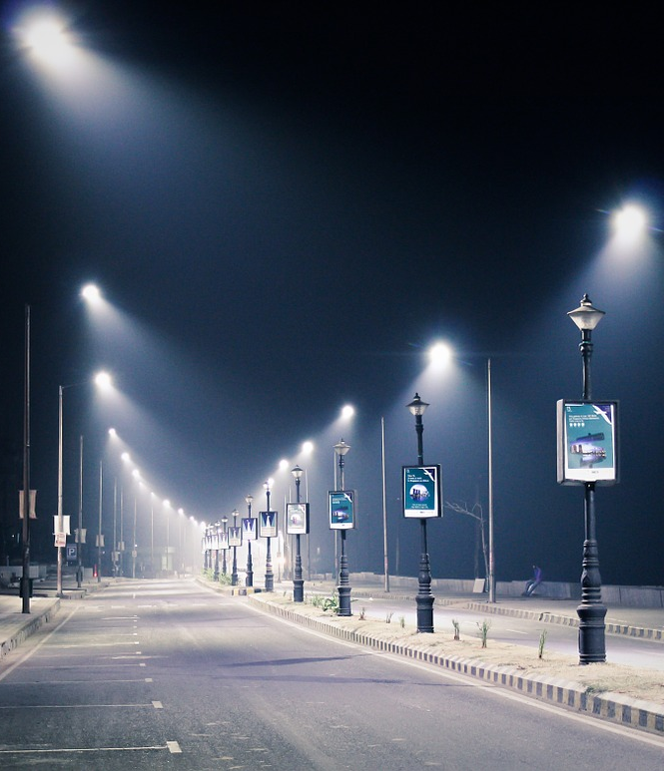
Street lighting analysis
Common technologies: High pressure sodium (HPS), Metal Halide (MH) and LED
Benefits of upgrading to LED
  Lower maintenance costs
  Improved lighting quality (color rendition)
  Improve perception of safety
  Reduced light pollution (better glare control)

Slide 44
Upfront lighting costs
LED costs are decreasing quickly – historical costs are often not reflective of current costs
Two upfront costs estimated in this analysis:
  High upfront fixture cost: Focus on Energy Technical Resource Manual
  Low upfront fixture cost: Estimated from conversations with WI cities implementing LED streetlight upgrades

Slide 45
LED lifetime cost analysis
 |  |  | High upfront cost |  |  | Low upfront cost
Lighting type | Lifetime Energy savings (kWh) | Lifetime CO₂ savings (metric tons) | Upfront cost | Lifetime Cost savings | Payback period (years) | Upfront cost | Lifetime Cost savings | Payback period (years)
70 W | 3,430 | 2.6 | $214 | $210 | 11.6 | $150 | $275 | 6.8
100 W | 7,750 | 5.9 | $214 | $605 | 5.6 | $150 | $670 | 3.9
150 W | 9,480 | 7.2 | $257 | $740 | 5 | $200 | $800 | 3.6
250 W | 16,070 | 12.2 | $346 | $1,270 | 3.7 | $300 | $1,315 | 3.3
400 W | 23,800 | 18.1 | $461 | $1,870 | 3.3 | $400 | $1,930 | 3

Slide 46
Fitchburg: streetlight annual savings summary
Streetlight annual savings
Number of lights | 1,016
Energy savings (kWh) | 285,000
CO₂ savings (metric tons) | 217
Energy cost savings | $31,350

Slide 47
Solar analysis

Slide 48
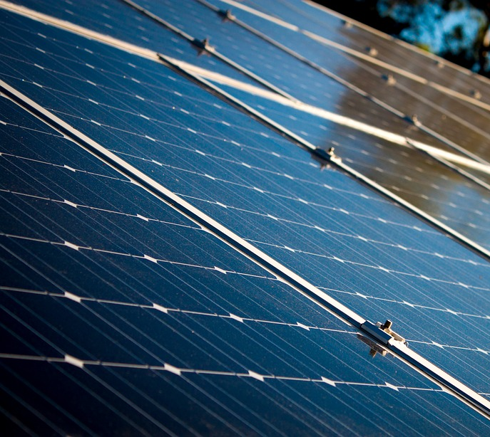
Solar opportunity analysis – process
High-level survey of solar potential for all facilities
  Roof size/available land
  Review of historical electric consumption
  Initial system size, production, and cost estimates
  Recommendation of 2-4 facilities with good solar potential
Individual meetings
  Review recommendations
  City feedback on site potential
  Identification of facilities for additional analysis
Remote site reviews
  Detailed roof measurements
  Identification of roof penetrations and other obstructions
  Potential array layout
  System modeling (NREL System Advisor Model)
  Update cost, capacity, and production estimates

Slide 49
Fitchburg – opportunity summary
Facility | Capacity (kW DC) | Production (kWh) | Electricity Offset | Net Cost
Fire Station | 65.1 | 92,315 | 66% | $107,954
Community Building | 37.2 | 46,131 | 28% | $61,689
Well 5 | 23.3 | 31,501 | 6% | $38,555
Well 10 | 67.0 | 94,532 | 34% | $111,039
Well 11 | 31.0 | 43,728 | 11% | $51,407
TOTAL | 223.5 | 308,207 | 27% | $370,644

Slide 50
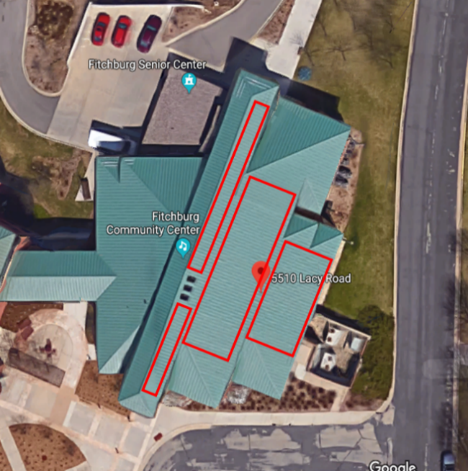
Community center potential array
Community Center – 5510 Lacy Rd
Energy Profile
Annual electric consumption: | 167,400 kWh
Potential array capacity | 37.2 kW DC
Annual production (est.) | 46,131 kWh
Share of consumption offset | 28%
Financial Performance
Total system cost (est.) | $72,575
Potential rebate | $10,886
Net cost | $61,689
Payback year | 13

Slide 51
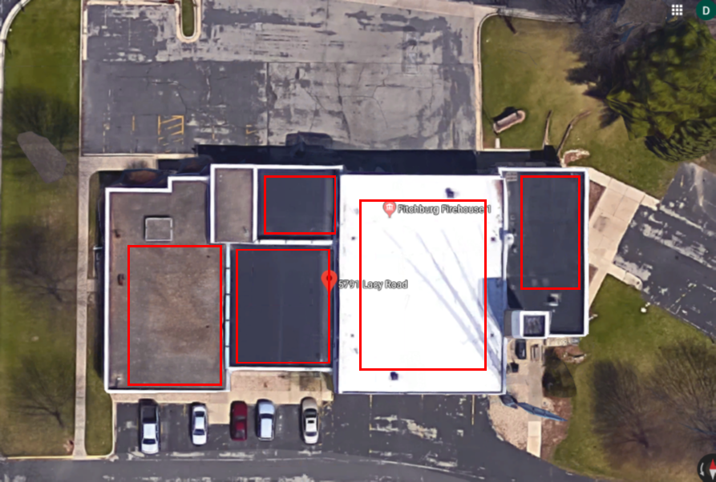
Fire station potential array
Fire Station – 5791 Lacy Rd
Energy Profile
Annual electric consumption: | 139,600 kWh
Potential array capacity | 65.1 kW DC
Annual production (est.) | 92,315 kWh
Share of consumption offset | 66%
Financial Performance
Total system cost (est.) | $127,005
Potential rebate | $19,051
Net cost | $107,954
Payback year | 11

Slide 52
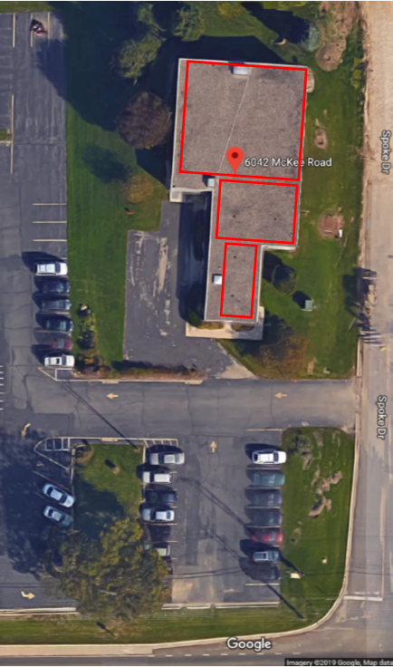
Well 5 potential array
Well 5 – 6042 McKee Rd.
Energy Profile
Annual electric consumption: | 584,164 kWh
Potential array capacity | 23.26 kW DC
Annual production (est.) | 31,501 kWh
Share of consumption offset | 5%
Financial Performance
Total system cost (est.) | $45,359
Potential rebate | $6,804
Net cost | $38,555
Payback year | 8

Slide 53
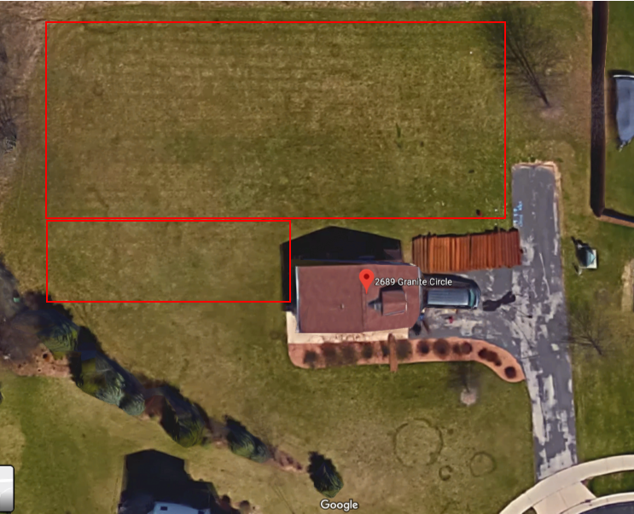
Well 10 potential array
Well 10 – 2689 Granite Cir.
Energy Profile
Annual electric consumption: | 249,014 kWh
Potential array capacity | 66.9 kW DC
Annual production (est.) | 94,532 kWh
Share of consumption offset | 38%
Financial Performance
Total system cost (est.) | $130,634
Potential rebate | $19,595
Net cost | $111,039
Payback year | 11

Slide 54
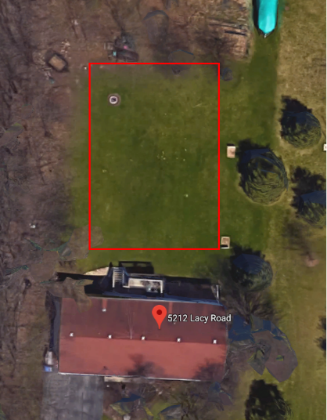
Well 11 potential array
Well 11 – 5212 Lacy Rd.
Energy Profile
Annual electric consumption: | 284,557 kWh
Potential array capacity | 31.02 kW DC
Annual production (est.) | 43,728 kWh
Share of consumption offset | 15%
Financial Performance
Total system cost (est.) | $60,479
Potential rebate | $9,072
Net cost | $51,407
Payback year | 11

Slide 55
Fitchburg – overall solar summary
Municipal Renewable Energy Opportunity | Kilowatt hours (kWh)
Current
Municipal Gross Electricity Consumption | 4,954,680
Net-metered solar production | 412,673
Export-metered solar production | 12,739
Other renewable electricity | 20,826
Total renewable electricity | 446,238
Percent renewable electricity | 9.0%
Opportunity
Annual additional solar production | 308,207
Total renewable electricity | 754,445
Percent renewable electricity | 15.2%

Slide 56
Solar analysis – questions to consider
Determine objective for PV installation at each site
Offset maximum percentage of current site consumption?
Identify non-energy factors affecting potential PV installations
Impact on neighboring properties
Evaluate ‘right’ size for each site
Do siting issues further limit array potential?
Offset maximum percentage of current municipal consumption?
Develop all sites with PV potential?
Visual confirmation of municipality’s commitment to clean energy?
Optimize financial performance?
Development plans for neighboring properties
Repair and replacement plans for building
How do utility rate capacity limitations affect financial performance?
How much capital is the municipality able to allocate to the project?
Do grant/rebate opportunities and amounts affect the right size for the project?

Slide 57
Municipal policies

Slide 58

Municipal Policy Checklist
Does your community track its energy data?
  Utility bills?
  Fleet fuel purchases?
Do you have a municipal benchmarking policy?
Are there policies to ensure efficient building operations and purchasing sustainable products?
Is there a new construction design guideline for municipal buildings?
Has the municipality identified a staff lead who will ensure policy moves forward?

Slide 59
Data collection considerations
Baseline metrics
Developing process for collecting data
Who will collect data?
Developing process for reporting and taking actions
Where will it be tracked?
When or how often?
How will data be processed?
What data should be tracked?
Energy profile for this energy plan is the first step
Update on a yearly basis to compare against baseline
Will the report be made public or used internally (or both?

Slide 60

Data collection tools: building data
ENERGY STAR® Portfolio Manager ®
Free online tool that allows users to review building Energy Use Intensity (EUI) and Energy Star Score

Slide 61
Data collection tools: fleet data
Fleet card
Vehicle telematics
Free service that provides cards specific to each vehicle
Use like credit cards at gas stations – must enter odometer reading and pin
Installed on individual vehicles
GPS and on-board diagnostics automatically report data
Data recorded:
- Mileage
- Fuel Usage
Data Recorded:
- Mileage
- Fuel use
- Idling periods
- Routes
- Maintenance needs
Dependent on user-inputted mileage
Cards can be lost/transferred between cars
Can be costly

Slide 62
Operational Policies
Operational Policies
Heating, ventilation, and air conditioning (HVAC) systems
Establish temperature setpoints and setbacks for occupied and unoccupied times
Keep a list of operating parameters, including the temperature set points and operating schedule, for each piece of equipment. Locate in visible locations to make sure equipment is programmed correctly.
Post guidance on when operable windows can be opened based on room thermostat setpoints. For example, assuming thermostats are set from 70 degrees to 75 degrees, building occupants should have clear direction that they can opened windows between 68-77 degrees outdoor temperature.
Create communication channels for building occupants to provide feedback on comfort or operational issues. A regularly administered survey can be useful to gather additional feedback on occupant comfort
Lighting systems
Promote or incentivize occupants to turn off switched lights when not in use.
Develop and communicate purchasing policy (see below) about replacing bulbs and fixtures
Plug loads
Develop a policy that prohibits or limits the use of individual fridges, space heaters , printers, and other peripheral equipment at workstations
Implement computer power management on worker’s computers using a 30 minute or less delay before putting computers to sleep. Consider ways to reduce the number of monitors at each work station

Slide 63
Purchasing Policies
Purchasing Policies
Heating, ventilation, and air conditioning (HVAC) systems
Install new air conditioning units with a SEER or IEER rating listed in Consortium for Energy Efficiency (CEE) Tier 2 or better.
Install new fans and pumps with EC motors or direct driven variable speed drives (VSDs).
Chillers should meet the Wisconsin Building Energy Code IPLV chiller efficiency ratings. Consider chillers with VFD driven screw compressors and magnetic bearing chillers for higher efficiency.
Install full-condensing boilers and gas heaters with listed efficiency of 92% or higher.
Consider installing or upgrading the building automation system when major equipment is replaced.
Lighting systems
LED lights should meet DLC QPL premium performance requirements.
Consider purchasing fixtures with integrated controls to automatically dim or shut off lights based on occupancy or daylight.
Consider Lighting networked controls that meet DLC Networked Lighting Control System QPL.
Plug loads
Implement an ENERGY STAR purchasing policy for all appliances, including refrigerators, computers, office equipment, kitchen equipment, washing machines, and clothes washers.
Use laptops instead of desktops at employee workstations.
Consider advanced power strips to turn off peripheral equipment, like monitors and task lights, when computers are turned off.

Slide 64
New construction design guidelines
Set an aggressive but feasible energy target*
Design the building to be resilient of climate change impacts, include back-up energy storage and incorporate flood risk mitigation or increased cooling needs
Design with distributed energy generation or design or solar ready building, which optimize orientation and roof properties
Include submeters to facilitate detailed benchmarking
Consider building certifications (LEED, Living Building Challenge, Well certification)
Include electric vehicle charging stations with sufficient capacity for growing EV market
Incorporate sustainable purchasing into the materials and design of the building
*refer to https://newbuildings.org/resource/zero-energy-commercial-building-targets/ for target EUIs for zero net energy buildings

Slide 65
Summary of recommendations

Slide 66
Recommendations summary
Building efficiency
LED upgrades
Lighting controls
HVAC controls
Streetlighting
LED lighting upgrades
Fleet
Police Hybrids
Light-duty electric vehicles
Solar
Policies / Processes
Framework for data collection
New construction design guidelines
Specific community investments
Community-specific policies
Phased installations
Policy for purchased renewable energy
Operational/ purchasing policies

Slide 67
Overall impact of energy investments
Opportunity | CO₂ reduction (metric tons) | Energy cost savings
Building efficiency | 213 | $30,585
Streetlights | 217 | $31,350
Fleet | 130 | $43,605
Solar | 235 | $33,900
Total | 795 | $139,440
Percent of current | 17% | 18%

